Slide 1



Google Cloud Platform
Acompañamiento
GCP – Google BigQuery
Noviembre de 2023
Notes:
1

Slide 2
AGENDA
Cost Calculator
BigQuery Recommender
BigQuery BI Engine
Metadata
Partitioning and Clustering
SQL syntax → Metadata & DML
Procedural Language
LAB
Notes:
2

Slide 3
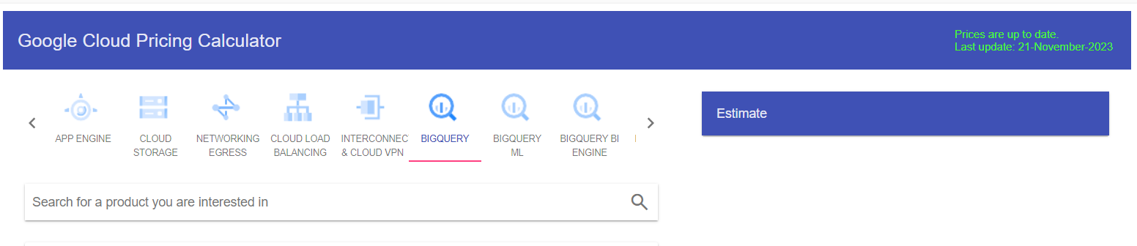
Calculator
Calculator
Notes:
3

Slide 4
Recommender
Notes:
4

Slide 5
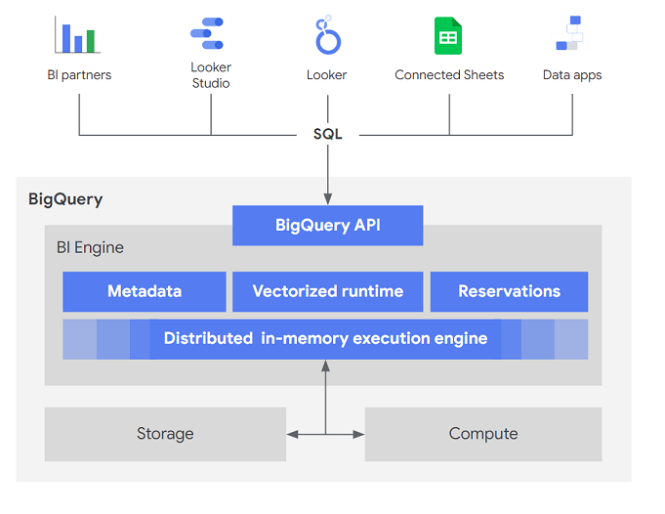
BigQuery BI Engine
Notes:
5

Slide 6
BigQuery BI Engine
SELECT * FROM <<PROYECT_ID>>.<<REGION_ID>>.
INFORMATION_SCHEMA.BI_CAPACITY_CHANGES;
ALTER BI_CAPACITY `PROJECT_ID.LOCATION_ID.default`
SET OPTIONS (
size_gb = VALUE,
preferred_tables = <ARRAY<STRING>>)
Notes:
6

Slide 7
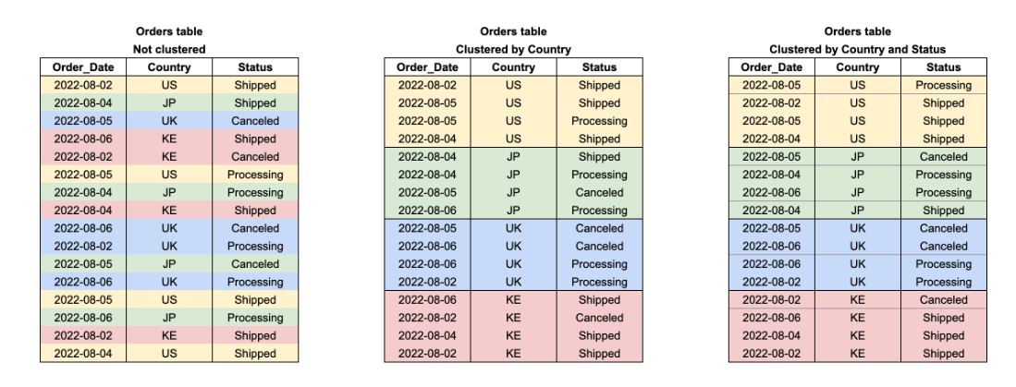
Partitiong and Clustering
Notes:
7

Slide 8
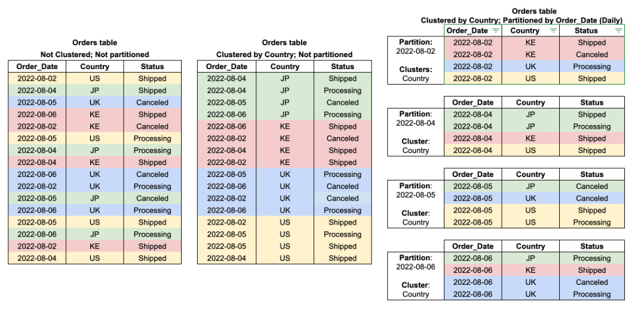
Partitiong and Clustering
Notes:
8

Slide 9
Partitiong and Clustering
CREATE TABLE
mydataset.newtable (transaction_id INT64, transaction_date DATE)
PARTITION BY
transaction_date
OPTIONS (
partition_expiration_days = 3,
require_partition_filter = TRUE);
CREATE TABLE
mydataset.newtable (transaction_id INT64, transaction_date DATE)
PARTITION BY
transaction_date
AS (
SELECT
transaction_id, transaction_date
FROM
mydataset.mytable);
Notes:
9

Slide 10
Metadata
SELECT * FROM `<<PROYECTO>>.<<DATASET>>.INFORMATION_SCHEMA.PARTITIONS`
SELECT * FROM `<<PROYECTO>>.<<DATASET>>.INFORMATION_SCHEMA.TABLES`
SELECT * FROM `<<PROYECTO>>.<<DATASET>>.INFORMATION_SCHEMA.COLUMNS`
SELECT * FROM `<<PROYECTO>>.<<DATASET>>.__TABLES__`
SELECT * FROM `region-eu.INFORMATION_SCHEMA.JOBS_BY_PROJECT`
Notes:
10

Slide 11
Data Manipulation Language
INSERT
DELETE
UPDATE
TRUNCATE
MERGE
Notes:
11

Slide 12
MERGE
MERGE `<<MY_PROJECT>>.<<MY_DATASET>>.<<TARGET_TABLE>>` T
USING `<<MY_PROJECT>>.<<MY_DATASET>>.<<SOURCE_TABLE>>` S
ON T.product = S.product
WHEN MATCHED THEN
UPDATE SET quantity = T.quantity + S.quantity
WHEN NOT MATCHED THEN
INSERT (product, quantity) VALUES(product, quantity)
Notes:
12

Slide 13
Procedural Language
Basic Syntax
Limit Loops
Limit Data Manipulation
Functions
Triggers
Stored Procedures
Error Handling
Transactions
Notes:
13

Slide 14
Function vs Stored Procedure
A function necessarily returns a value, while a procedure may or may not return a value or may return more than one value.
Stored Procedures will normally be used for specific tasks.
Functions will be used to calculate a value.
Stored Procedure allows DML statement (INSERT/DELETE/MERGE)
Functions can be called in SELECT /WHERE/… statements.

Slide 15
Transactions
Atomicity → all transaction operations are performed as a single unit.
Consistency → a transaction cannot affect the consistency of the db.
Isolation → a transaction is independent of other transactions; this means that each transaction is treated as the only one in the whole system.
Durability → once committed all changes performed by any transaction, those must be permanent.

Slide 16
BEGIN TRANSACTION;
-- Create a temporary table that holds new arrivals from 'warehouse #1'.
CREATE TEMP TABLE tmp
AS SELECT * FROM `<<MY_PROJECT>>.<<MY_DATASET>>.<<SOURCE_TABLE>>` WHERE warehouse = 'warehouse #1';
-- Delete the matching records from the NewArravals table.
DELETE `<<MY_PROJECT>>.<<MY_DATASET>>.<<SOURCE_TABLE>>` WHERE warehouse = 'warehouse #1';
-- Merge the records from the temporary table into the Inventory table.
MERGE `<<MY_PROJECT>>.<<MY_DATASET>>.<<TARGET_TABLE>>` AS I
USING tmp AS T
ON I.product = T.product
WHEN NOT MATCHED THEN
INSERT(product, quantity, supply_constrained)
VALUES(product, quantity, false)
WHEN MATCHED THEN
UPDATE SET quantity = I.quantity + T.quantity;
-- Drop the temporary table and commit the transaction.
DROP TABLE tmp;
COMMIT TRANSACTION;

Slide 17
Transactions
BEGIN
BEGIN TRANSACTION;
INSERT INTO mydataset.NewArrivals
VALUES ('top load washer', 100, 'warehouse #1');
-- Trigger an error.
SELECT 1/0;
COMMIT TRANSACTION;
EXCEPTION WHEN ERROR THEN
-- Roll back the transaction inside the exception handler.
SELECT @@error.message;
ROLLBACK TRANSACTION;
END;

Slide 18
Hora de practicar

Slide 19



“Si puedes imaginarlo podemos hacerlo”
Gracias por tu atención

